Slide 1
Research Project Covid19-India

Slide 2

1. Find Top 3 Affected Age Groups and their Percentage
Query:
Select * from agegroupdetails order by TotalCases desc limit 3;
Output:

Slide 3
Discussion
People whose age is between 20 to 49 are more affected by Covid19. Specifically for the 20 to 29 age group. The percentage effect for them is 24.86 percent. As per the given specified date, the number od total case for them is 172. Next is 146 for the 30-39 group of people. 112 cases for 40-49 age groups. The percentage for them are 21.10 and 16.18 respectively.

Slide 4
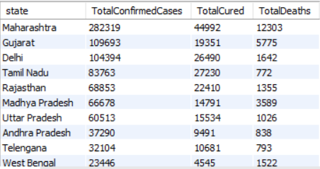
2. State Wise Total Confirmed, Total Cured, Total Death Cases. Show the Confirmed in Descending Order
Output:
Query:
select state, sum(Confirmed) as TotalConfirmedCases,sum(Cured) as TotalCured, sum(Deaths) as TotalDeaths from covid_19_india group by State order by 2 desc;

Slide 5
Discussion
From 30-01-2020 to 11-05-2020, the total number of confirmed cases are presented based on states. If we mark those states as rank then the 1st rank is Maharashtra, 2nd rank is Gujrat, 3rd rank is Delhi, and so on. The number of confirmed cases of that states are 282319, 109693, 104349, and so on. If we consider total cured and deaths, then Maharashtra also holds the first position. The amount of total cured in Delhi and Tamil Nadu are 26490 and 27230 respectively. But the cured in Gujrat is 19351. So as per the cured, Tamil Nadu holds the second position then Delhi. After that Rajasthan then Gujrat.

Slide 6
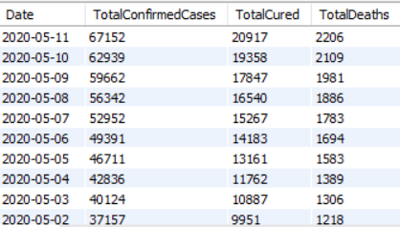
3. Date Wise Total Confirmed, Total Cured, Total Death Cases. Show the Confirmed in Descending Order
Query:
select str_to_date(Date,'%d-%m-%Y') as Date, sum(Confirmed) as TotalConfirmedCases,sum(Cured) as TotalCured, sum(Deaths) as TotalDeaths from covid_19_india group by str_to_date(Date,'%d-%m-%Y') order by 2 desc;
Output:

Slide 7
Discussion
From 30-01-2020 to 11-05-2020, the total number of confirmed cases are presented based on dates. The output is shown in descending order based on the confirmed cases column. So the date column in the output screen also demonstrates that it is also in descending order. The last day of the taken dataset is the maximum number of Confirmed cases i.e. 67152. Next is 10th May 2020 and then 9th May 2020. So that we can say, day by day it is increasing. Total cured and deaths are also in the same manner as the Confirmed cases.

Slide 8
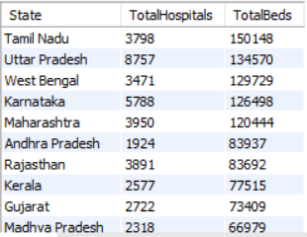
4. State wise Total Hospitals and Total Beds Available. Show Total Beds in Descending Order
Query:
select State, TotalPublicHealthFacilities_HMIS+NumRuralHospitals_NHP18+ NumUrbanHospitals_NHP18 as TotalHospitals, NumPublicBeds_HMIS+NumRuralBeds_NHP18+NumUrbanBeds_NHP18 as TotalBeds from hospitalbedsindia order by 3 desc;
Output:

Slide 9
Discussion
Tamil Nadu has the maximum number of beds across India. Utter Pradesh holds the second position and West Bengal holds the third position. The number of beds of those states are 150148, 134570, and 129729 respectively. As per the number of hospitals, Utter Pradesh holds the 1st position with 8757 hospitals. Karnataka and Maharashtra hold the 2nd and 3rd positions with 5788 and 3950 number of hospitals respectively.

Slide 10
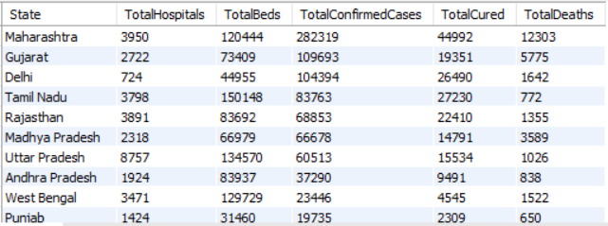
5. Compare State wise Total Hospitals, Beds and Total Confirmed Cases, Cured, Deaths.
Query:
select temp1.state,totalhospitals,totalbeds,TotalConfirmedCases,TotalCured,TotalDeaths from(select State, TotalPublicHealthFacilities_HMIS+NumRuralHospitals_NHP18+ NumUrbanHospitals_NHP18 as TotalHospitals, NumPublicBeds_HMIS+NumRuralBeds_NHP18+NumUrbanBeds_NHP18 as TotalBeds from hospitalbedsindia) as Temp1,(select state, sum(Confirmed) as TotalConfirmedCases,sum(Cured) as TotalCured, sum(Deaths) as TotalDeaths from covid_19_india group by State) as Temp2 where temp1.State=temp2.State order by TotalConfirmedCases desc;
Output:

Slide 11
Discussion
As we can see, Maharashtra has the maximum number of cases but the sate has fewer hospitals and beds. Whereas Tamil Nadu holds the 4th position on positive cases but has maximum beds across India. Utter Pradesh and West Bengal have 2nd and 3rd positions on the number of beds but have less positive cases compared to Gujrat and Delhi. Number of cured are relatively same for the number of positive cases except for Gujrat.

Slide 12
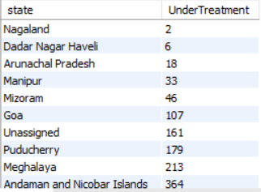
6. Find the State wise Number of Patient who are Now Under Treatment. Show Less Effected States First.
Query:
Select state, TotalConfirmedCases-(TotalCured+TotalDeaths) as UnderTreatment from(select state, sum(Confirmed) as TotalConfirmedCases,sum(Cured) as TotalCured, sum(Deaths) as TotalDeaths from covid_19_india group by State) as Temp order by 2;
Output:

Slide 13
Discussion
Under-Treatment patients are shown in the output. Nagaland has less effected cases where 2 patients are currently under treatment. The next state is Dadra Nagar Haveli with 6, Arunachal Pradesh with 18, and so on.

Slide 14
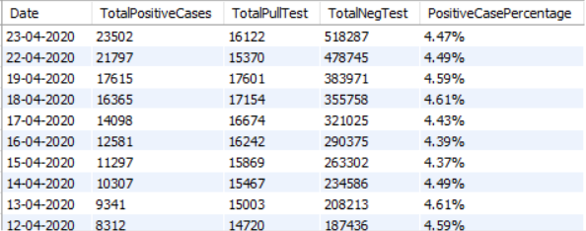
7. Find Total Positive Cases (in Descending Order), Total Pull Tests, Total Negative Tests, and Positive Cases Percentage
Query:
select left(DateTime,10) as Date, TotalPositiveCases,TotalSamplesTested-TotalIndividualsTested as TotalPullTest, TotalSamplesTested-TotalPositiveCases as TotalNegTest, concat(round((TotalPositiveCases*100)/TotalIndividualsTested,2),'%') as PositiveCasePercentage from icmrtestingdetails order by cast(TotalPositiveCases as signed) desc;
Output:

Slide 15
Discussion
The Date range is from 13-03-2020 to 27-04-2020 (For this table).
The maximum positive cases are 23502 on 23-04-2020. As per the data, the number of positive cases is increasing i.e. the date and positive cases are directly proportional to each other. The percentage of positive cases is based on the total sample tested on each date. As per the recent data, it is almost the same i.e. 4.4 to 4.6%. After that, it gradually decreasing. So, we can say that the percentage is also in the proportional relation with the date column.

Slide 16
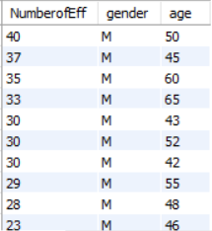
8. Gender and Age (after 40) Wise Effected People. Maximum Effected People at First
Query:
select count(id) as NumberofEff, gender, age from individualdetails where age>40group by gender,ageorder by 1 desc;
Output:

Slide 17
Discussion
Male persons whose ages between 42-55 are more affected in covid19. 40 male people have affected from 31-01-2020 to 26-04-2020 and the age group is 50 at position no 1. 2nd is age group 45 male with 37 affected. 3rd is the age group 60 male with 35 affected. As per females are a concern, 45 to 60 age groups are quite in an affected danger zone.

Slide 18
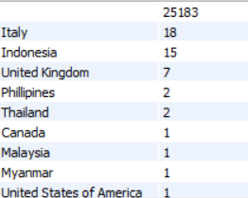
9. Number of Effected Persons who Nationality is not Indian
Query:
select nationality, count(id) as NumberofEff from individualdetails where nationality <> 'India' group by nationality order by 2 desc;
Output:

Slide 19
Discussion
1st row has not identified the name of the nation due to incomplete data but as per the query that must those persons whose nationality is not Indian. If we consider from row number 2, Italy holds the 1st position, Indonesia 2nd position, UK 3rd position, and so on.

Slide 20
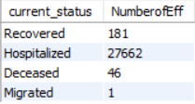
10. Group the Data Using Current Status and Show the Number of People
Query:
select current_status, count(id) as NumberofEff from individualdetails group by current_status;
Output:

Slide 21
Discussion
In this particular duration, maximum people are hospitalized and the number of persons are 27662.

Slide 22
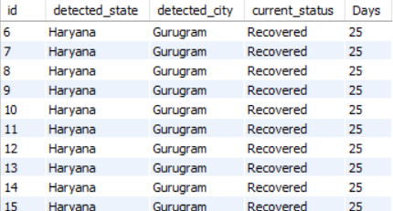
11. List the Number of Patients who have Recovered. Show Their Id, States, City, Current Status and Max Days to Recover
Query:
select id, detected_state,detected_city,current_status,datediff(str_to_date(left(status_change_date,10),'%d-%m-%Y'),str_to_date(left(diagnosed_date,10),'%d-%m-%Y')) as Daysfrom individualdetails where current_status='Recovered' order by 5 desc;
Output:

Slide 23
Discussion
A maximum of 25 days are required to recover from covid19. As per the initial results, all those persons who are recovered from those all are from the same state and same city as well. Everybody has taken 25 days to recover.

Slide 24
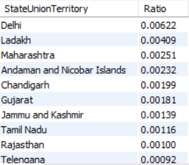
12. Find State wise Positive Cases and Population Ratio
Query:
select StateUnionTerritory,round(TotalConfirmedCases/Population,5) as Ratio from(select StateUnionTerritory,Population from population_india_census2011) as temp1,(select state, sum(Confirmed) as TotalConfirmedCases from covid_19_india group by State) as temp2 where temp1.StateUnionTerritory=temp2.state order by 2 desc;
Output:

Slide 25
Discussion
As per the Positive Cases versus Population Ratio, Delhi holds the 1st position with ratio = 0.00622. This means 622 people have effected per 1 lakh. Ladakh holds the 2nd position and Maharashtra holds the 3rd position with 0.00409 and 0.00251 respectively.

Slide 26
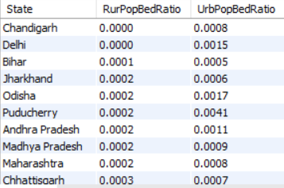
13. Find Population wise Hospital Bed Ratio for Rural and Urban Area
Query:
select State,NumRuralBeds_NHP18/RuralPopulation as RurPopBedRatio,NumUrbanBeds_NHP18/UrbanPopulation as UrbPopBedRatio from(select State,RuralPopulation,NumRuralHospitals_NHP18,NumRuralBeds_NHP18,UrbanPopulation,NumUrbanHospitals_NHP18,NumUrbanBeds_NHP18 from(select StateUnionTerritory,RuralPopulation,UrbanPopulation from population_india_census2011) as temp1,(select State,NumRuralHospitals_NHP18,NumRuralBeds_NHP18,NumUrbanHospitals_NHP18,NumUrbanBeds_NHP18 from hospitalbedsindia) as temp2 where temp1.StateUnionTerritory=temp2.state) as temp3 order by 2;
Output:

Slide 27
Discussion
The query plays a vital role that shows population-wise available beds for both rural and urban areas. The query is written in such a way that the main subquery should return a master table which contains state wise Rural Population, Number of Rural Hospitals, Number of Rural Beds, Urban Population, Number of Urban Hospitals, and Number of Urban Beds. After the query, it demonstrates that Chandigarh and Delhi have no hospital beds in rural areas per 10,000 people in the state. Whereas in urban areas that have 8 and 15 beds/ 10,000 people respectively.

Slide 28
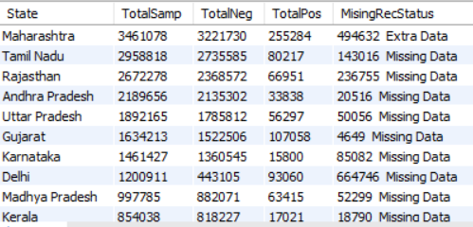
14. Find State Wise Total Sample Tested, Total Positive, Total Negative, and Missing Record Status
Query:
select State, sum(TotalSamples) as TotalSamp, sum(Negative) as TotalNeg, sum(Positive) as TotalPos, if(sum(TotalSamples)-sum(Negative)-sum(Positive)<0,(CONCAT(sum(TotalSamples)-sum(Negative)-sum(Positive)*-1,' ','Extra Data')),(CONCAT(sum(TotalSamples)-sum(Negative)-sum(Positive),' ','Missing Data'))) as MisingRecStatus from statewisetestingdetails group by State order by 2 desc;
Output:

Slide 29
Discussion
Maharashtra has the maximum number of sample tests. 2nd is Tamil Nadu and 3rd is Rajasthan. After that, there is another column for missing data records. Maharashtra has 494632 extra data, Tamil Nadu has 143016 missing data, Rajasthan has 236755 missing data, and so on. So all the states have not given actual positive and negative records.

Slide 30
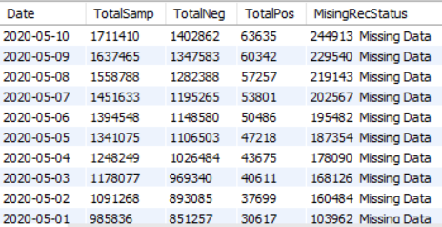
15. Find Date Wise Total Sample Tested, Total Positive, Total Negative, and Missing Record Status
Query:
select str_to_date(Date,'%d-%m-%Y') as Date,sum(TotalSamples) as TotalSamp, sum(Negative) as TotalNeg, sum(Positive) as TotalPos, if(sum(TotalSamples)-sum(Negative)-sum(Positive)<0,(CONCAT(sum(TotalSamples)-sum(Negative)-sum(Positive)*-1,' ','Extra Data')),(CONCAT(sum(TotalSamples)-sum(Negative)-sum(Positive),' ','Missing Data'))) as MisingRecStatus from statewisetestingdetails group by str_to_date(Date,'%d-%m-%Y') order by 2 desc;
Output:

Slide 31
Discussion
10th May has the maximum number of sample tests. The 2nd is on 9th May and the 3rd is on 8th May. After that, there is another column for missing data records. 10th may have 244913 missing data, 9th may have 229540 missing data, 8th may have 219143 missing data, and so on. So every day all the hospitals have not given actual positive and negative records. Sample testing is increasing day by day along with missing data also increasing day by day.

Slide 32
Thank You

